Slide 1





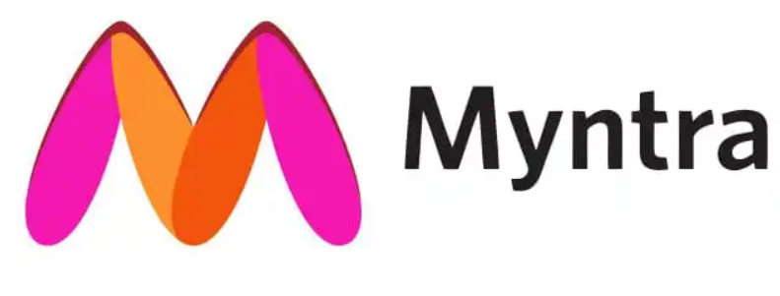
- Yashwanthini Aishwariya B

Slide 2
Introduction
Myntra is India's leading online fashion platform, offering a wide range of clothing, footwear, and accessories for men, women, and children. It is known for its user-friendly interface, extensive product catalog, and frequent sales and discounts. It also offers personalized recommendations based on customer browsing history and preferences.
Value proposition
Myntra's value proposition revolves around giving consumers the power and ease of purchasing fashion and lifestyle products online. Offerings such as the largest in-season product catalogue, 100% authentic products, cash on delivery and 30 day return policy make Myntra, the preferred shopping destination in the country.
Recognitions
Awarded 'Fashion eRetailer of the Year 2013' by Franchise India – Indian e- Retail Awards
Awarded 'Best E-commerce Website for 2012' by IAMAI – India Digital Awards
Awarded 'Images Most Admired Retailer of the Year: Non–Store Retail' for 2012 by Images Group
Awarded 'Best E-commerce Partner of the year 2011-12' by Puma India

Slide 3
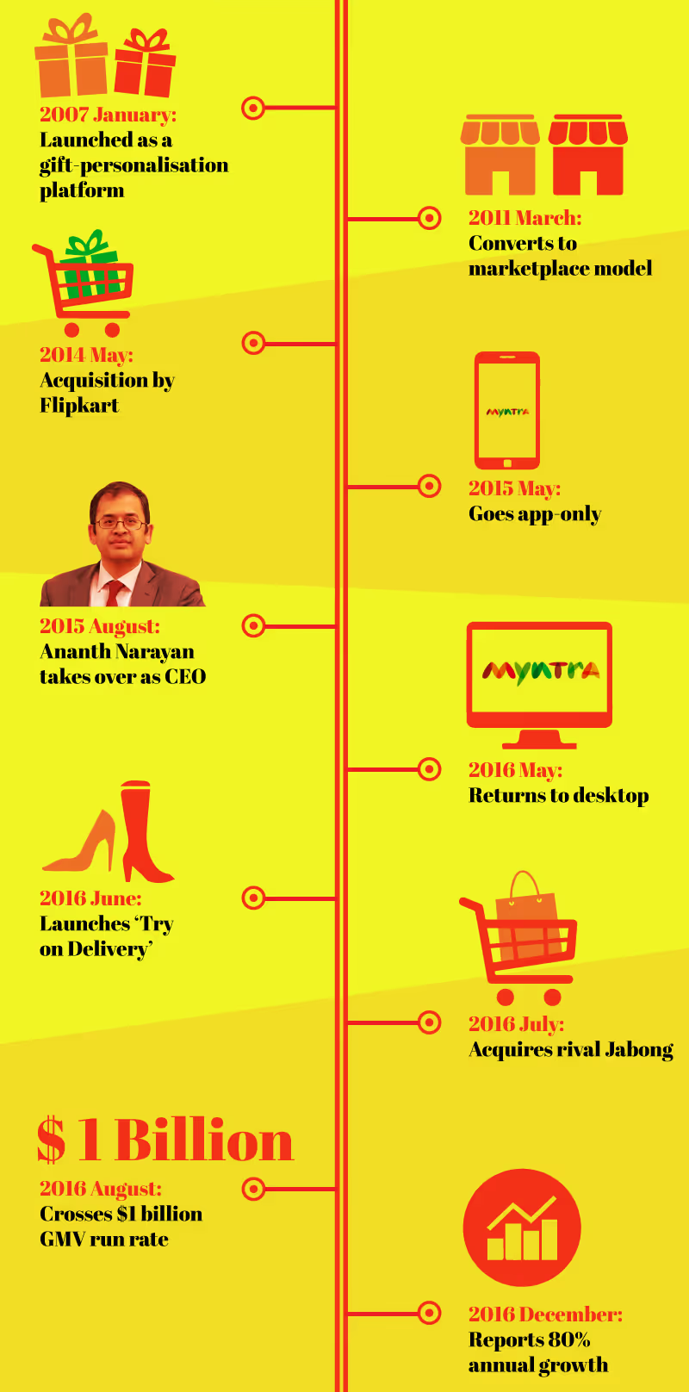
history
Business model
Myntra is a B2C eCommerce fashion brand and Myntra's business model is based on a marketplace approach, where it partners with various brands and artisans to offer a broad selection of products. This model allows Myntra to earn revenue through commissions on sales made by third-party sellers on its platform. Additionally, Myntra generates income from exclusive brand partnerships and advertising.

Slide 4

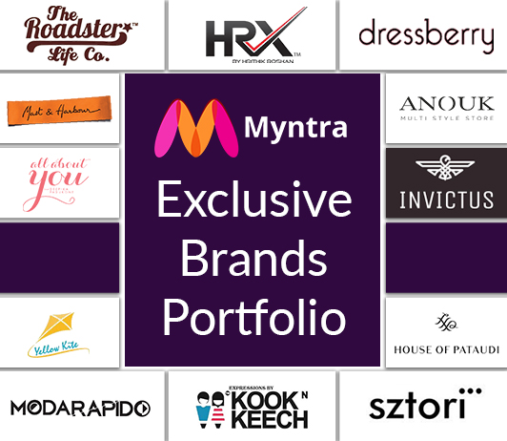
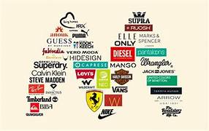



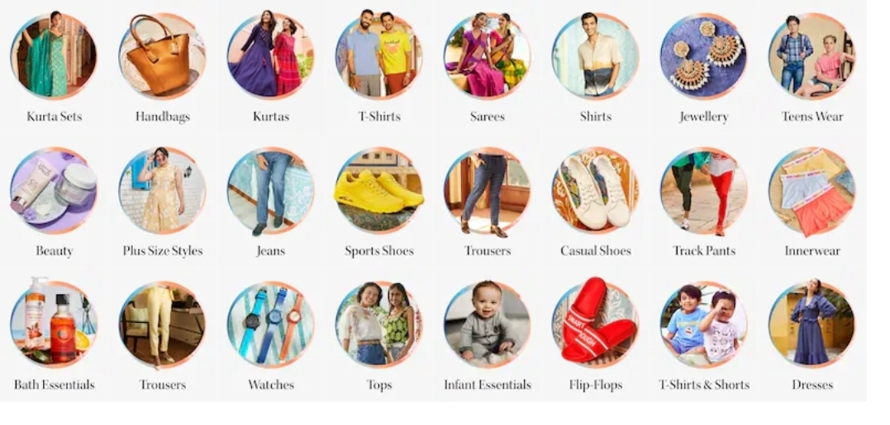
Brands

Slide 5
RANK OF MYNTRA
Global Rank:
Myntra's global rank in August 2024 was 530.
Country Rank:
Myntra holds the 101st position in India.
Category Rank:
In the Apparel and Fashion category, Myntra ranks at the top in India.
Traffic:
Myntra receives approximately 41.45 million monthly visits.

Slide 6
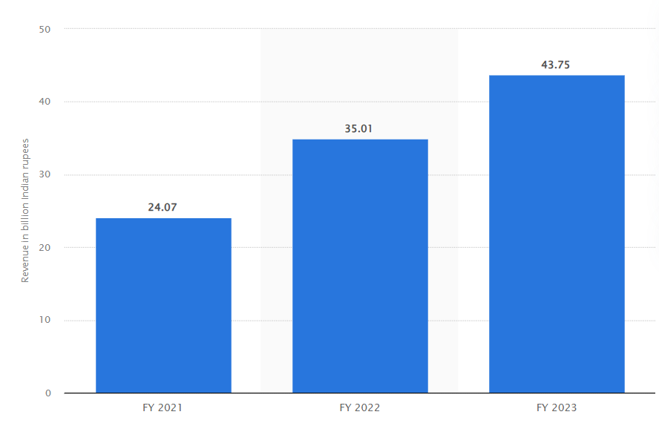
REVENUE OF MYNTRA
As of 2023, Myntra's operating revenue was reported to be 43.75 billion Indian rupees.
This represented a significant increase from the previous year. It's important to note that while Myntra has seen growth in revenue, it has also faced challenges in terms of profitability.

Slide 7
TECHNOLOGY USED IN MYNTRA
1.Cloud Computing:
2. E-commerce Platform
3. Mobile App Development
4. Search Engine Optimization (SEO)
5. Artificial Intelligence (AI) and Machine Learning
6. Big Data Analytics
7. Content Management System (CMS)
8. Payment Gateways
9. Logistics and Supply Chain Management
10. Data Security

Slide 8
Market trend OF MYNTRA
Mobile-first approach
Omnichannel retailing:
Personalization
Influencer marketing
Sustainable fashion
Quick commerce
Live streaming
Virtual try-on

Slide 9
Sentimental analysis
The sentimental analysis is done by using Various hashtags of Myntra.
The perception of customers is collected by their reviews
The reviews were collected with the help of social media platform like Instagram, face book and twitter
Instagram
Positive | 82
Negative | 22
Neutral | 52
Positive
Neutral
Youtube
Negative
Positive | 63
Negative | 7
Neutral | 23

Slide 10
Competitors OF Myntra
Amazon, Ajio, Flipkart and Meesho are some of the e-commerce website and these are considered as competitors of Myntra.
Amazon Market Leader: Amazon is the world's largest online retailer, dominating the e-commerce market globally. Operating Revenue: While exact figures vary, Amazon's revenue is significantly higher than Myntra's. Rank: Amazon consistently holds the top position in global e-commerce rankings. | Flipkart Indian Giant: Flipkart is a major Indian e-commerce player, competing directly with Amazon in the Indian market. Operating Revenue: Flipkart's revenue is substantial and has been growing steadily. Rank: It often ranks second in India after Amazon, but its position can fluctuate based on market dynamics. | Ajio Fashion Focus: Ajio is a fashion-focused e-commerce platform owned by Reliance Retail. Operating Revenue: While specific figures are not publicly available, Ajio's revenue is likely significant, especially in the Indian fashion market. Rank: Ajio likely ranks among the top e-commerce platforms in India, though its exact position may vary. | Meesho Social Commerce: Meesho is a social commerce platform that connects sellers and buyers. Operating Revenue: Meesho's revenue is growing rapidly, especially in the Indian market. Rank: Its rank among e-commerce platforms is rising, though it may still be behind the larger players like Amazon and Flipkart.

Slide 11
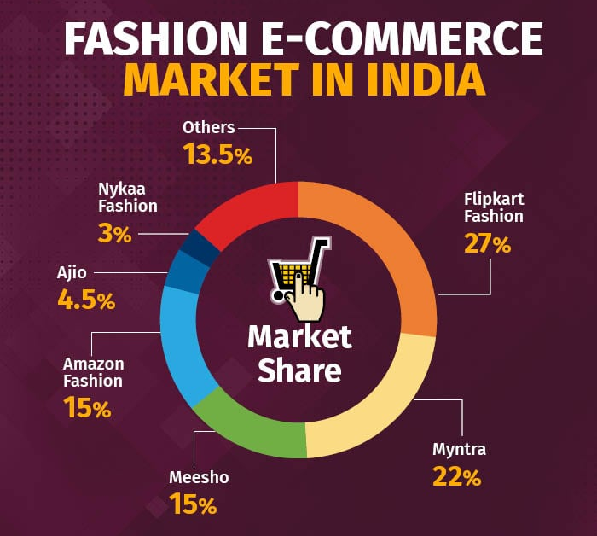
Market share of fashion e-commerce

Slide 12
Strength & Weakness of Myntra’s competitors
AMAZON
AJIO
STRENGTH Wide variety of products Easy to find most products Easy returns process Good customer service Prime membership benefits (fast delivery, discounts, etc.) | WEAKNESS Delivery and Tracking Issues Customer Support problems Product quality and service concerns Payment issues
STRENGTH Affordable price Trendy collection Tracking facility Easy returns Fast delivery Frequent deals and discounts Easy to return | WEAKNESS Delivery delays Product quality Returns & exchange Order cancellation Incorrect deliveries Coupon issues

Slide 13
Strength & Weakness of Myntra’s competitors
FLIPKART
MEESHO
STRENGTH Wide range of products Competitive prices Reliable source with good packing Deals and discounts Easy to return | WEAKNESS Pricing errors Product availability Customer service Delivery issues App crashes Difficulty in payment methods Inconvenience to track the order
STRENGTH Affordable price Wide variety of products Cash on delivery Easy to use Attractive discounts and deals Good customer service | WEAKNESS Difficulty in returning items Delays in delivery Damaged products Low quality products

Slide 14
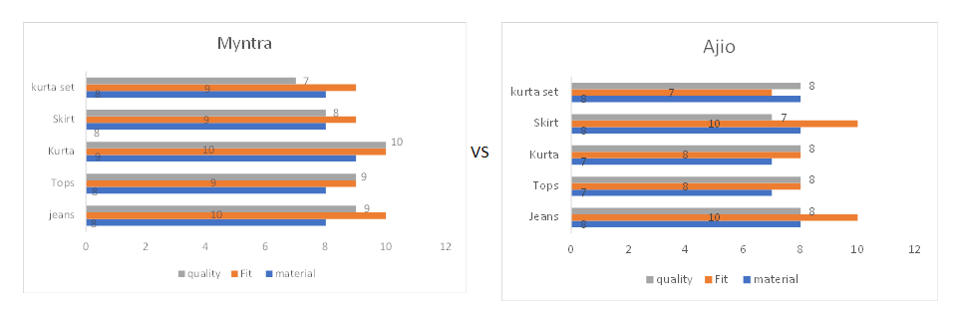
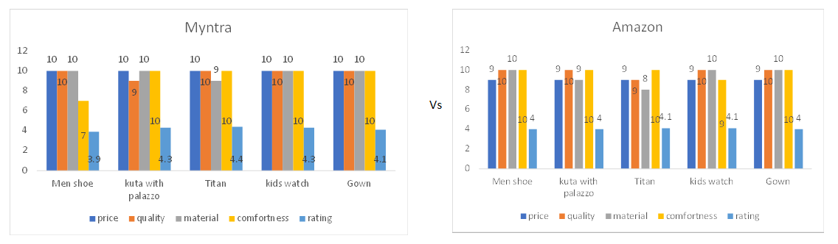
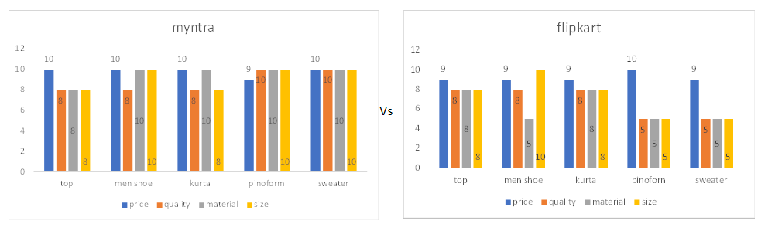
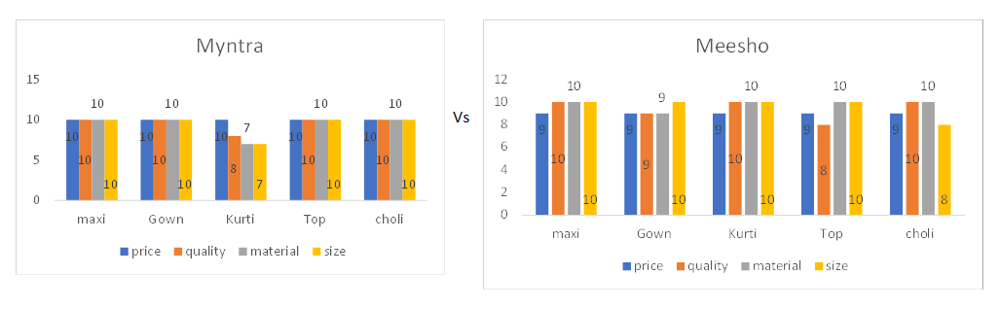
Myntra Vs competitors of Myntra
Based on similar products

Slide 15
Myntra’s advantages & disadvantages
Advantages Quality Material Huge collection No app or website crashes Best customer support Lot of payment options inclusing payment layer | Disadvantages No reverse logistics Dissatisfaction with return policies and refund processes Accusations of fraud and cheating Complaints about delayed or incorrect deliveries Issues with customer service responses and problem resolution

Slide 16
Strategic recommendation
Focus on Sustainability and Ethical Sourcing
Increase the availability of sustainable and eco-friendly products.
Supply chain optimization
Implement advanced technologies to streamline the supply chain, reduce delivery times, and improve efficiency.
Improve Delivery and Logistics:
Explore partnerships with logistics providers to reduce delivery times, especially in urban areas.
Provide customers with real-time updates on their order status.
Provide reverse logistics
Enhance customer service
Ensure round-the-clock availability of customer support channels.

Slide 17



Thank you

